Slide 1



INTERNAL · AI LITERACY
How Claude Works
Giulio Ruffini
Neuroelectrics/BCOM/Starlab · April 2026
A short tour: LLMs, training, the prompt stack, and sandboxes.
Notes:
I want to spend about fifteen minutes giving you a mental model of what's actually happening when you talk to Claude — not a sales pitch, the under-the-hood. By the end you'll know why prompts behave the way they do, why we keep mentioning markdown, and why Cowork and Claude Code are basically the same thing wearing different shirts. Importantly, the same technology is used by other providers (Geming and openAI), so you can port a lot of what you read here over to those if you need.

Slide 2
LESSON 1
What is an LLM?
input tokens
LLM
next-token probabilities
A Large Language Model is a neural network that predicts the next token (a word piece) given everything that came before.
The
network
brain
LLM
machine
is
P(next token)
mystery
Transformer architecture.
Billions of parameters (≈ tunable numbers).
Output = next-token loop, one token at a time, until a stop signal.
a
…
Prediction at scale ⇒ compression ⇒ world models.
How Claude Works · Giulio Ruffini
2
Notes:
Underneath everything, there's one trick: predict the next token. A token is roughly a word piece — "prediction" might split into "pre", "dict", "ion". The model sees everything that came before, computes a probability distribution over the next token, samples one, and loops. No master plan in advance — the whole answer emerges one token at a time. Pause on what that actually requires. To predict well across the entire space of human text — physics, history, code, jurisprudence, lab notes — the network has nowhere to keep a lookup table. The space of possible continuations is combinatorially explosive. The only way to do well at this task is to compress — to find the regularities in the data and encode them. And the regularities in human-generated text are not artefacts of language; they are the regularities of the world that produced the text. Physical, social, mathematical, linguistic. So a sufficiently good next-token predictor is forced, by the geometry of its task, to build internal models of the world. Compression and understanding are two sides of the same coin — that's the algorithmic-information / Kolmogorov view. This is why the "stochastic parrot" framing of LLMs misses the point. A parrot copies sequences; it does not compress them into models. An LLM that merely parroted would have plateaued at GPT-2 — the empirical fact that scale keeps yielding qualitatively new behaviors is evidence that the network is finding ever deeper, more compressive abstractions. The models aren't perfect, and we'll get to their failure modes, but they are models. The argument that "it's just statistics" usually comes from people who don't take statistics — or compression — seriously enough.

Slide 3
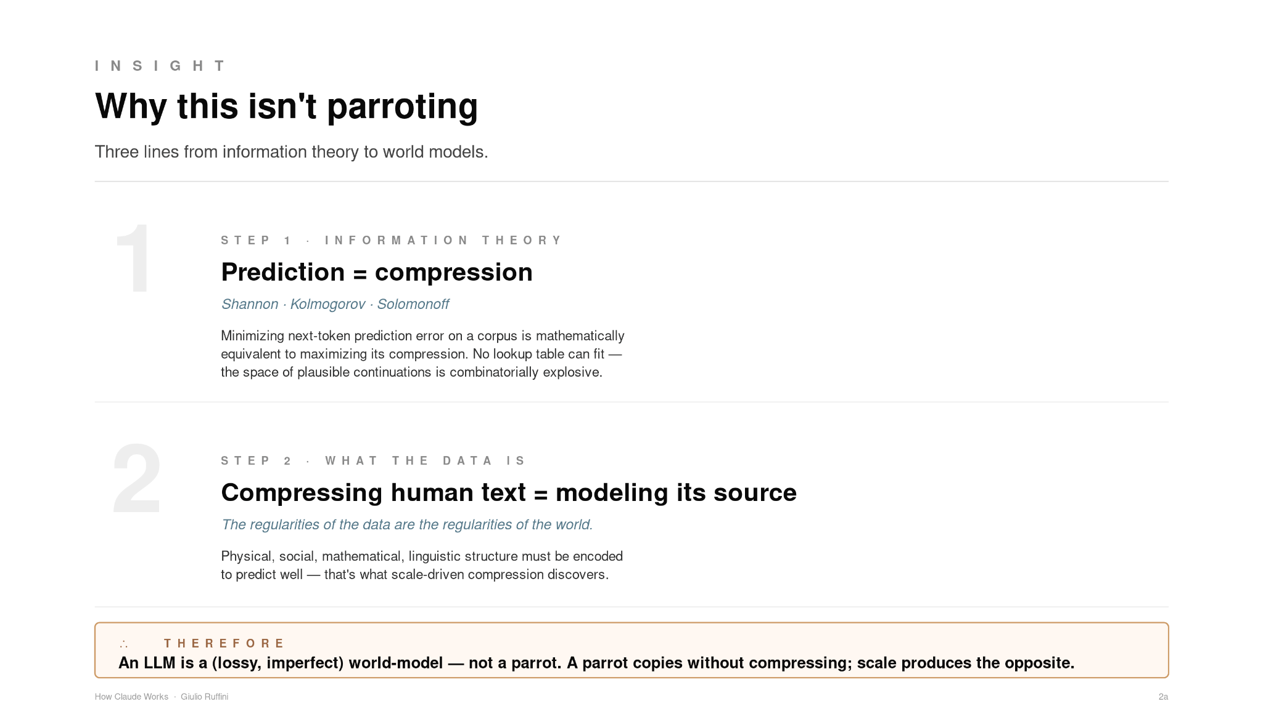
Notes:
Quick aside before we get into weights. I want to head off the most common pushback you'll hear about LLMs: "It's just statistics. It's a stochastic parrot." Three lines from information theory dispatch that argument cleanly.
Step one. Predicting the next token at scale is, mathematically, the same task as compression. Shannon, Kolmogorov, Solomonoff — all of classical information theory says: minimizing prediction error on a corpus equals maximizing how compactly you can encode it. There is no lookup table that could substitute, because the space of plausible continuations across all human text is combinatorially explosive. The model has no choice but to compress.
Step two. The data being compressed is human-generated text — and the regularities in that text are not artefacts of language. They're the regularities of the world that produced the text: physical, social, mathematical, linguistic. To compress them well, the network has to encode them.
Therefore — and this follows: a competent next-token predictor is, by the geometry of its training task, a (lossy, imperfect, sometimes confidently wrong) model of the world. A parrot copies without compressing. Scale doesn't produce parrots — it produces increasingly compressive abstractions. That's why scaling keeps working, and it's why this deck spends time on context engineering: you're shaping how the model uses its world-model, not patching one in.

Slide 4
PRIMER
What are “weights”?
A neural network is a graph of connections with numbers. The weights are those numbers — and training is how they're learned.
hidden layers
A weight is a number.
Learned during training.
w = 0.42
Every line between nodes carries one number — the weight.
Training nudges all of them until outputs get good.
A big LLM has ~10¹¹ of them (hundreds of billions).
Running the model = multiply + add, many times over.
Input
Hidden
Hidden
Output
Every “intelligent” thing Claude does comes from numbers like this one.
How Claude Works · Giulio Ruffini
3
Notes:
Every line on this diagram has one number on it — that's a weight. A modern LLM has roughly 10 to the 11 of them. Hundreds of billions. Training is the process of nudging all those numbers until the outputs get good. When you 'run' the model you're doing matrix multiplications with those numbers. There's no symbolic logic — just numbers learned and a handful of operation. That's the entire substrate. A neural network graph that has learned to predict the next token after a long sentence. I have of course hidden some important (crucial) details, like how words are translate into numbers (you cannot multiply letters!), a process called “embedding”.

Slide 5
LESSON 2
Training the LLM · Step 1 — pretraining
The base model is taught to predict the next token on a vast mix of public and licensed text — essentially "guess the next word" at massive scale.
Web pages
Books
Base model
Code
Input: trillions of tokens of text and code.
Objective: minimize prediction error on held-out text.
Output: a general-purpose statistical model of language and reasoning: a compressed model of the data — and therefore, implicitly, of the world that produced it.
Cost: large clusters of GPUs running for weeks to months.
Papers
Conversations
Knows a lot — but not yet well-behaved.
How Claude Works · Giulio Ruffini
5
Notes:
Step one of training: dump trillions of tokens of text into the model — web, books, papers, code — and ask it to predict the next token, over and over. The objective is shockingly mundane. But from that simple goal, language, reasoning, and code understanding emerge. They must: it would otherwise be impossible to predict the next token with finite resources (combinatorics are crazy)! The answer: the model compresses, it implicitly encode a World Model (a mathematical beast). Predict-next-token" is not an arbitrary objective. Information-theoretically, minimizing prediction error on a corpus is maximizing the compression of that corpus. So pretraining is, mathematically, a compression task. World models are not a goal of training — they are an unavoidable side-effect of doing the compression well. Today the process is very inefficient and the cost is enormous: large GPU clusters running for weeks to months. The output is the base model. It knows a lot, but it isn't yet polite, helpful, or honest. Talking to a raw base model is a strange experience. This is no small part due to the fact that most of the text it has seen is terrible, gibberish from the internet with some useful stuff.

Slide 6
LESSON 3
Training the LLM · Step 2 — the RL step (alignment)
The raw base model (weights!) is imitative, not cooperative. A second stage — Reinforcement Learning from Human (and AI) Feedback — teaches it to be helpful, honest, and harmless. Weights are updated.
1. Generate
2. Compare
LLM produces several candidate answers.
Humans rank answers by quality.
3. Reward
4. Update
Humans compare model answers and rank them.
A reward model learns to predict those preferences.
The LLM is fine-tuned (via RL) to maximize that reward.
Anthropic also uses Constitutional AI — a written set of principles the model is trained to follow.
A reward model learns those preferences.
Policy is fine-tuned by RL.
↻ repeat
How Claude Works · Giulio Ruffini
6
Notes:
Step two turns the base model into something you'd actually want to talk to. Humans rank pairs of answers — 'this one is better than that one.' A small reward model learns those rankings. Then we fine-tune the LLM with reinforcement learning to maximize that reward. Anthropic adds a twist called Constitutional AI: instead of only human ranking, the model critiques itself against a written constitution of principles. That's a big part of why Claude tends to be honest about uncertainty and careful about safety.

Slide 7
ZOOM IN
Inside the AI Model — LLM (weights) + markdown
What does "Claude Opus 4.6" actually mean? Two things, working together.
1. The neural network
2. Your Markdown
Frozen weights — trained once, shipped
Runtime context — read fresh every session
Input tokens
CLAUDE.md — project + user instructions
Token embeddings
SKILL.md (pptx, xlsx, …) — how to do a task well
Self-attention + Feedforward
User preferences — style, language, habits
Self-attention + Feedforward
× N
Self-attention + Feedforward
Conversation history — what we've said so far
Next-token probabilities
Your message — the new request
Learned parameters — the “knowledge” baked in at training time.
Claude Opus 4.6 = frozen weights (what it knows) + your Markdown (how it behaves today).
How Claude Works · Giulio Ruffini
4
Notes:
This is the most important slide in the deck — pause on it. The model has two parts working together. On the left, frozen weights — what was baked in at training. They don't change between conversations. On the right, your markdown — CLAUDE.md, SKILL.md, your message. Read fresh every single time you hit enter. So when you write a CLAUDE.md or a Project instruction, you are not retraining anything — you're shaping the context the frozen model reads. That distinction is the whole leverage point of using Claude well at NE.

Slide 8
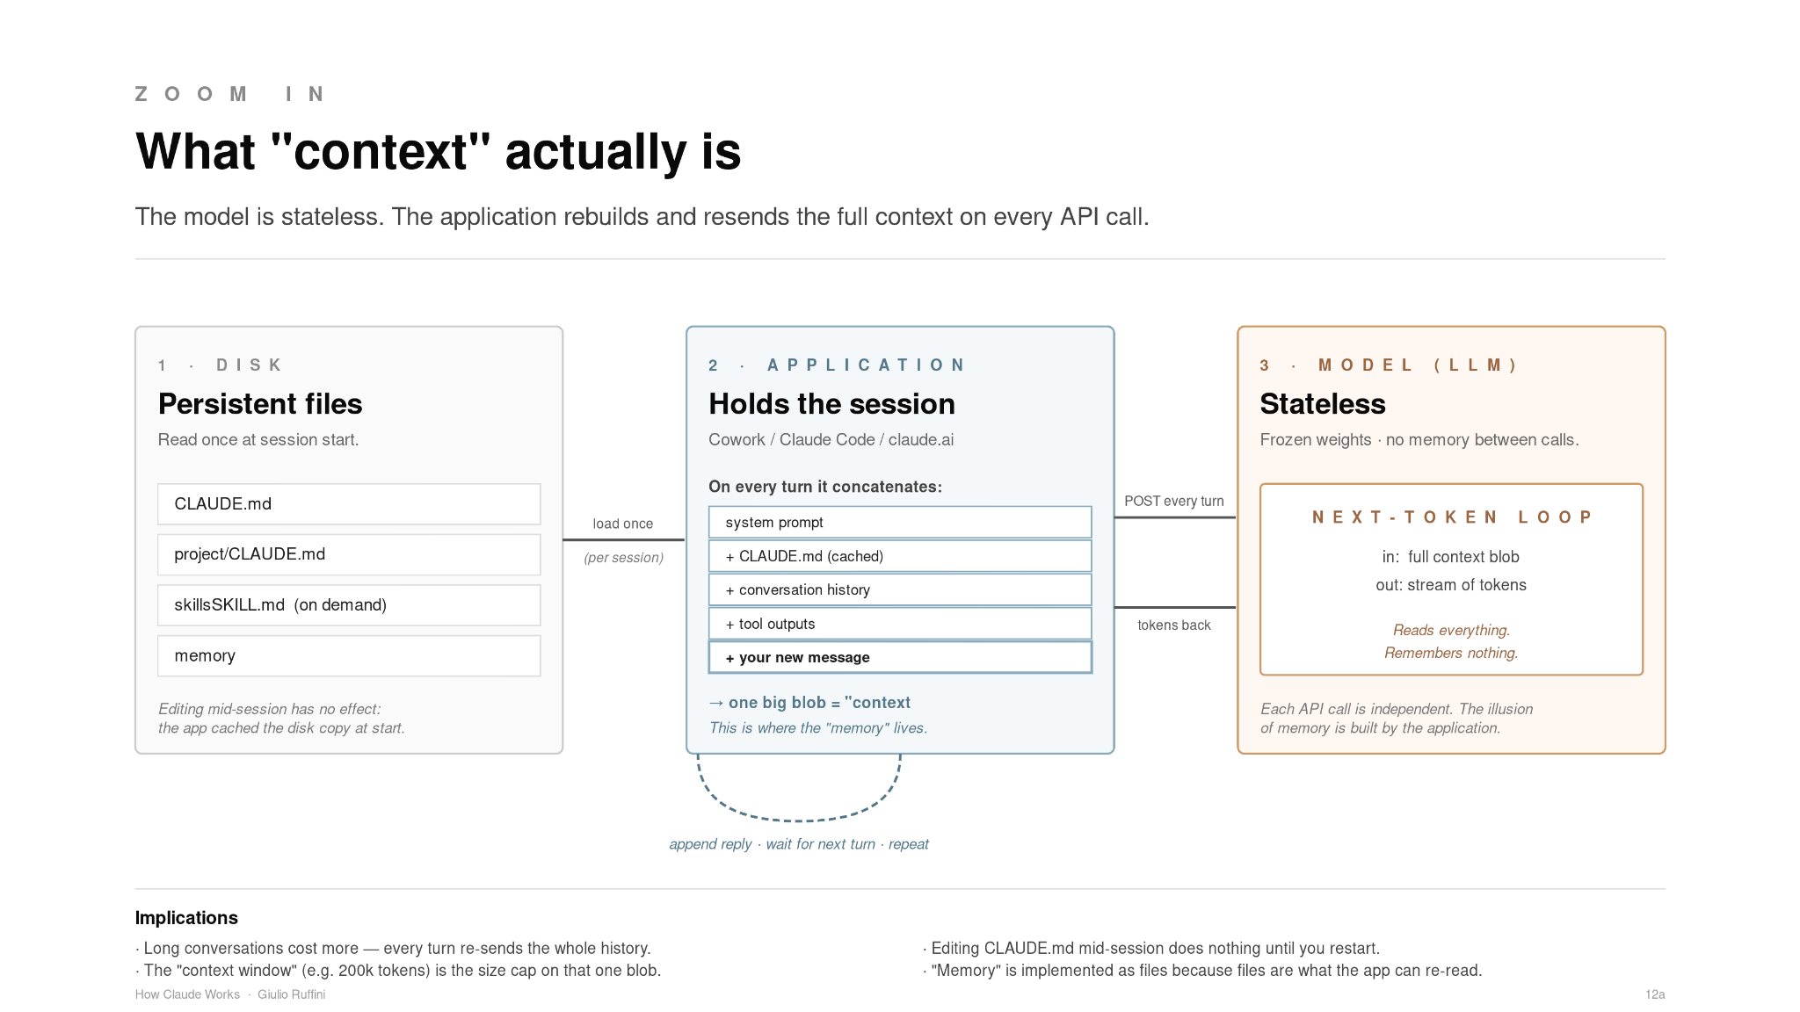
The LLM is stateless. "Context" is the full blob — system prompt + CLAUDE.md + history + your message — that the application rebuilds and sends on every API call. The illusion of memory lives in the app, not the model.
Notes:
Here's a subtlety worth pausing on. The model itself has no memory — it is stateless. Every time you hit enter, the application around the model — Cowork, Claude Code, claude.ai — rebuilds the entire context from scratch and sends it as one big blob: the system prompt, your CLAUDE dot md, the conversation so far, any tool outputs, and your new message. The model reads it, predicts the next tokens, and forgets. The application then appends the reply to its conversation log and, on your next turn, sends the whole thing again — slightly longer this time. So "context" isn't something the model has; it's something the application reconstructs and resends on every API call. Memory lives in the application, not the model. This explains four practical things: long conversations get expensive because every turn re-sends the full history; the context window is the size cap on that one blob; editing CLAUDE.md mid-session has no effect because the app already cached the disk copy at session start; and "memory" in Claude is implemented as files, because files are the only thing the app can re-read and re-inject next time.

Slide 9
SIDEBAR
A quick detour — what is a Markdown (.md) file?
Every file we've mentioned — CLAUDE.md, SKILL.md, memory.md — is a Markdown file. Here's why that format keeps showing up.
What is it?
Why AI loves it
Plain text + a few conventions for structure.
The format that fell into AI's lap
example.md
Plain text — no binary, no proprietary format, every tool can read it.
LLMs are trained on enormous volumes of it: GitHub READMEs, docs, blogs, Stack Overflow.
Headings, lists, and emphasis survive tokenization cleanly — structure is unambiguous.
Humans write it in any editor; machines parse it in one line.
One file works as both source and rendered document.
# My Project
## Rules
- Always use American English.
- **Never** commit secrets.
Markdown was invented by John Gruber and Aaron Swartz in 2004. It's readable as source and renders to HTML anywhere.
If Claude has a native file format, this is it.
How Claude Works · Giulio Ruffini
8
Notes:
Quick detour, because we keep saying 'markdown.' It's a 2004 invention by John Gruber and Aaron Swartz — plain text plus a few conventions: # for headings, - for lists, **bold**. Why does AI love it? It's everywhere in the training data — GitHub READMEs, docs, blogs, Stack Overflow — so the model has internalized it. It tokenizes cleanly so structure survives. Humans can read it raw; machines can parse it in one line. If Claude had a native file format, this is it.

Slide 10
LESSON 4
What the model actually sees on every query
Each message you send is wrapped in layers of instructions. The whole stack becomes the model's context — the text it "sees" before it answers. Zooming into the blob from the previous slide — here's what gets concatenated, in priority order.
Your message
what you just typed
Reading the stack
Conversation history
previous turns in the session
Top = most specific / most recent.
Bottom = most general / always-on.
Higher-priority rules usually win when in conflict.
A Project is just a shared claude.md + files that anyone on that project inherits.
User preferences
e.g. "always use American English"
Project claude.md
instructions checked into this folder
one combined
context window
Global CLAUDE.md
your personal, cross-project rules
Skills & tools
pptx, xlsx, pdf, MCP connectors …
System prompt
Anthropic's core behavior and safety rules
How Claude Works · Giulio Ruffini
7
Notes:
When you send a message, the model doesn't just see the message. Behind it is a stack: Anthropic's system prompt at the bottom, then your global CLAUDE.md, then the project CLAUDE.md, then any active skills, then conversation history, then your message at the top. All of it gets concatenated into one big string and that's the prompt. Top of the stack = more specific = usually wins when there's a conflict. A 'Project' on claude.ai is just a shared CLAUDE.md plus uploaded files that anyone on the project inherits. Once you internalize this picture, prompt engineering stops being magic and becomes 'design the stack.'

Slide 11
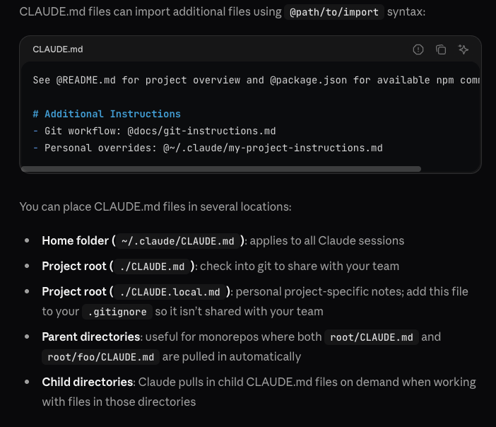
Here are some example context files used by Claude: it is a hierarchical system!
How Claude Works · Giulio Ruffini
Notes:
Here are some example context files used by Claude: it is a hierarchical system!

Slide 12
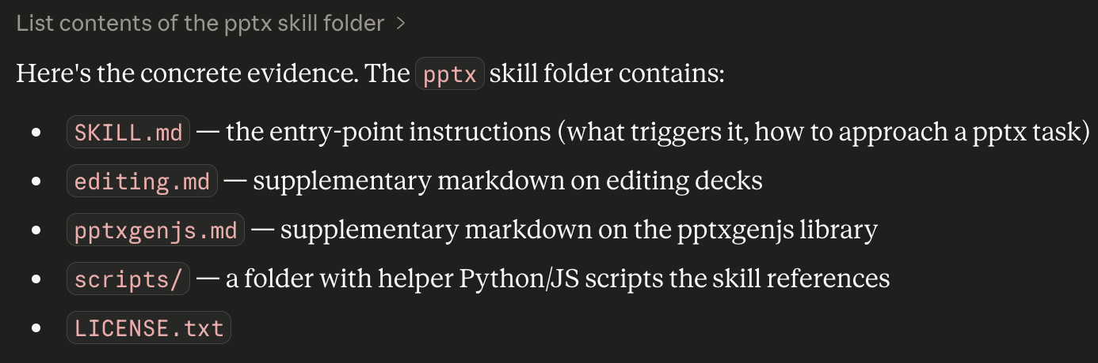
LESSON 5
Skills and tools — how Claude reaches out
On top of the base model, Claude is extended with modular capabilities.
Skills
Tools and MCP
Reusable instruction packages
Functions Claude can call
Small folders with a SKILL.md and scripts that teaches Claude a specific workflow.
Examples: pptx, xlsx, pdf, canvas-design, skill-creator.
Loaded on demand when the task matches the skill's description.
Your organization can write its own — e.g. a DHF-drafting skill for RAQA.
Built-in tools: Read, Write, Edit, Bash, WebSearch, WebFetch.
MCP connectors: Gmail, Calendar, Drive, Notion, Linear, Figma, your own servers.
Each tool call is explicit — Claude asks, the host executes, results come back.
MCP = the standard "USB-C for AI" — any compliant service plugs in.
https://code.claude.com/docs/en/best-practices
How Claude Works · Giulio Ruffini
9
Notes:
Two ways Claude is extended beyond pure text generation. Skills are reusable instruction folders — basically a recipe Claude reads when the task matches the description. There's a pptx skill for slides, xlsx for spreadsheets, pdf, canvas-design, and others. They load on demand — Claude doesn't carry them all in working memory. Tools and MCP are functions Claude can actually call: read a file, search the web, query Gmail, hit our internal API. MCP is the standard — think of it as USB-C for AI — any compliant service plugs in. NE-relevant punchline: we can write our own. A DHF-drafting skill, an Enobio-data MCP, a NIC log analyzer — all well within scope.

Slide 13
LESSON 6
What is a sandbox?
A sandbox is an isolated, disposable environment where code runs with no access to the host system except what you explicitly grant.
Isolated
Ephemeral
Restricted
Safe
Separate filesystem,
users, processes.
State is wiped
between sessions.
Limited network;
no secrets or keys.
Arbitrary code
cannot harm host.
Think of it as a locked workshop: Claude can build, test, and throw things — the main building stays safe.
How Claude Works · Giulio Ruffini
10
Notes:
A sandbox is an isolated, disposable environment. Separate filesystem. State wiped between sessions. Restricted network — no secrets or keys exposed. Whatever code runs inside can't reach the host. Think of a locked workshop on a factory floor: Claude can build things, test them, even break them — and the rest of the building stays safe.

Slide 14
LESSON 7
Where Claude runs — two sandbox models
Chat (claude.ai)
File-native Claude
Server-side sandbox
Local sandbox, bound to a folder you pick
Runs in a disposable container on Anthropic's servers.
No access to your computer's filesystem.
Files you upload are copied in; files it creates are downloaded.
State resets between conversations (unless you use a Project).
Great for: drafting, Q&A, quick code, research.
One architecture, several surfaces — see badges below.
Reads and edits files directly on your machine.
Can run code, use computer-use, call MCP connectors.
Memory and skills persist inside the selected folder.
Great for: real work on real files — this deck, for example.
same architecture, different surfaces:
Claude Code (CLI)
Cowork (desktop)
Claude app (agent panel)
Rule of thumb: Chat is a whiteboard. File-native Claude is a workshop in your actual office.
How Claude Works · Giulio Ruffini
11
Notes:
Two flavors. Chat — claude.ai in the browser — runs in a sandbox on Anthropic's servers. Files you upload get copied in, anything Claude creates gets downloaded back. State resets between conversations unless you use Projects. Great for drafting, Q&A, quick code, research. File-native Claude — that's Claude Code, Cowork, and the agent panel inside the desktop app — runs a sandbox locally, bound to a folder you pick. It reads and edits your actual files, runs code, talks to MCP connectors. Memory persists inside that folder. Different surfaces, one underlying architecture. Rule of thumb: chat is a whiteboard; file-native is a workshop in your actual office.

Slide 15
WRAP-UP
What to remember
1
It's a next-token predictor.
Trained on huge text corpora, then aligned with human feedback.
2
Every answer is shaped by its context stack.
System prompt + CLAUDE.md files + skills + your message. Rules near the top usually win.
3
Chat is server-side; everything else is file-native.
Claude Code, Cowork, and the Claude-app agent panel all share one local-sandbox architecture.
4
Skills and MCP are where your leverage grows.
NE can build its own skills and connectors around devices, protocols, and the DHF pipeline.
"It's just statistics" misses the point.
5
A predictor that good must compress; a compressor that good must model. The frozen weights are an implicit world-model — that's what makes the prompt stack worth designing.
Further reading: docs.claude.com · anthropic.com/research · modelcontextprotocol.io
Notes:
Four things to walk out with. One: it's a next-token predictor — sophisticated autocomplete, no homunculus. Two: every answer is shaped by the context stack, not just your message — that's your leverage. Three: Chat is server-side; Code, Cowork, and the agent panel are one shared file-native architecture. Four: Skills and MCP are where NE's leverage grows — that's where we build our own toolbox around devices, protocols, and the DHF pipeline. Five: Finally, "It's just statistics" misses the point. A predictor that good must compress; a compressor that good must model. The frozen weights are an implicit world-model — that's what makes the prompt stack worth designing.Further reading is on the slide. Questions?

